Slide 1
Repetition Structures(Loops)and Jump Statements

Slide 2
Contents
Introduction to repetition structure
The while loop
The for Loop using range function
Using for to write a count-controlled loop
The break, continue, and pass statements
Nested Loops

Slide 3
Introduction to Repetition Structures
Often have to write code that performs the same task multiple times
Disadvantages to duplicating code
Makes program large
Time consuming
May need to be corrected in many places
Repetition structure: makes computer repeat included code as necessary
Includes condition-controlled loops and count-controlled loops

Slide 4

Repetition: Computer View
Continuing a process as long as a certain condition has been met.
How old are?
How old are?
Ask for age as long as the answer is negative (outside allowable range)
Minus 21!
Minus 21!

Slide 5
Pre - test loop
While
For
Characteristics:
The stopping condition is checked before the body executes.
These types of loops execute zero or more times.

Slide 6
The while Loop: a Condition-Controlled Loop
while loop: while condition is true, do something
Two parts:
Condition tested for true or false value
Statements repeated as long as condition is true
In flow chart, line goes back to previous part
General format/syntax:
while condition:
statement1
statement2

Slide 7
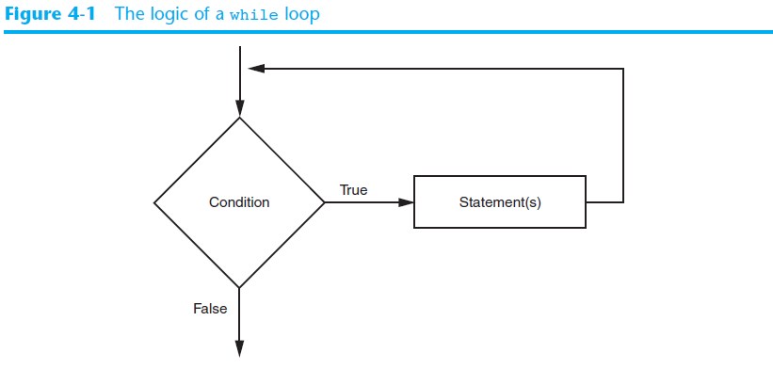
The while Loop: a Condition-Controlled Loop (cont’d.)

Slide 8
The while Loop: a Condition-Controlled Loop (cont’d.)
In order for a loop to stop executing, something has to happen inside the loop to make the condition false
Iteration: one execution of the body of a loop
while loop is known as a pretest loop
Tests condition before performing an iteration
Will never execute if condition is false to start with
Requires performing some steps prior to the loop

Slide 9
While as Pre-Test Loops
Initialize loop control
Check if the repeating condition has been met
If it’s been met then go to Step 3
If it hasn’t been met then the loop ends
Execute the body of the loop (the part to be repeated)
Update the loop control
Go to step 2
Initialize loop control
Condition met?
No
Yes
Execute body/statement
Update control
After the loop (done looping)

Slide 10
Examples
x =1 #initialization
while(x<1): #test condition
print("x is:",x)
x+=1 # update control
x =1 #initialization
while(x<10): #test condition
print("x is:",x)
x+=1 # update control
x =1
y=5
while(x < 100 and y==5):
print("x is:",x)
x = x + 1
x =1 #initialization
while(x<10): #test condition
print("x is:",x)

Slide 11
Exercise
WAP to display all numbers between 100 to 500 that are divisible by 7.
WAP to find the sum of all numbers between 1000 to 50 that are divisible by 9 and 13
WAP to find a multiplication table of a given number.
WAP to reverse a number. For example: 321 is 123.

Slide 12
Number between 100-500 divisible by 7
x= 100 while(x<=500): if(x%7==0): print(x) x+=1

Slide 13
Example: To find sum
x = 1000 sum = 0 while (x >= 50): if (x % 7 == 0 and x % 13 == 0): sum = sum + x x = x - 1 print(sum)

Slide 14
Example: Multiplication
x=1 y=int(input("Enter a value \t")) while(x <= 10): print(y,"*",x,"=",x*y) x = x+1

Slide 15
Reverse
y=int(input("Enter a value")) reverse = 0 while(y > 0): z = y % 10 #print("Z=",z) reverse = reverse * 10 + z #print("reverse:",reverse) y = y//10 print(reverse)

Slide 16
Infinite Loops
Loops must contain within themselves a way to terminate
Something inside a while loop must eventually make the condition false
Infinite loop: loop that does not have a way of stopping
Repeats until program is interrupted
Occurs when programmer forgets to include stopping code in the loop

